Slide 1
Robot Hand Challenge
www.destinationspace.uk
www.destinationspace.uk

Slide 2
Can YOU be a Space Robotics Engineer?
Your challenge is to construct, test, and improve the design of a robot hand that can grip and lift objects.
Tim Peake, the UK’s first European Space Agency Astronaut spent 6 years training for his mission to the International Space Station (ISS). Part of his training involved learning how to use the CANADARM 2, a robotic arm that he can control from inside the ISS.
www.destinationspace.uk
www.destinationspace.uk

Slide 3
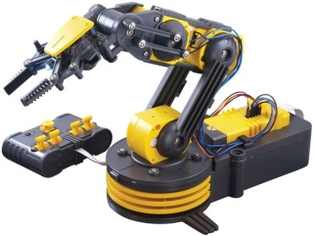
Canadarm2
The ISS has a robotic arm: Canadarm2
Astronauts can control the arm remotely from inside the station.
Why do you think astronauts use a robotic arm?
An internet connection is required to watch this video

Slide 4
Copying the human hand
While robots allow us to perform tasks remotely, and safely there are some tasks that the human body is perfectly designed for.
Engineers often try to copy the best features of a human, and improve on them – like with the Robonaut robot that has been tested on the ISS.
www.destinationspace.uk
www.destinationspace.uk

Slide 5
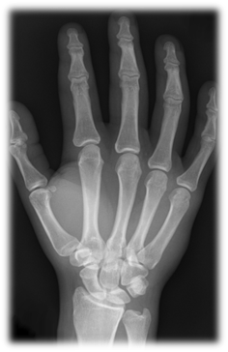
Copying the human hand
Most hands have four fingers and a thumb. The fingers have three bones and the thumb has 2 bones (the finger bones are called phalanges). These are connected to bones in the palm which connect to bones in the wrist and so on.
www.destinationspace.uk
www.destinationspace.uk

Slide 6
Flexors and Extensors
To open and close the hand you need stretchy material that is connected to the bones and can pull on them in different directions. These are called MUSCLES and TENDONS. FLEXOR muscles and tendons cause the fingers to bend, while EXTENSORS cause them to straighten out.
In the picture you can see the flexor and extensor muscles for the arm. Can you describe what each muscle has to do to let you lift your forearm then drop it again?
www.destinationspace.uk
www.destinationspace.uk

Slide 7
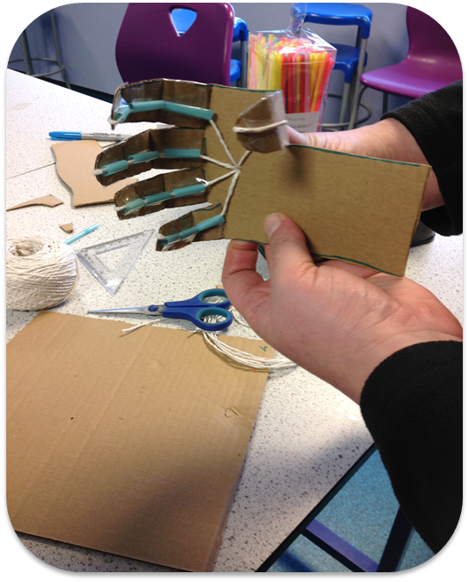
Challenge
Follow the instructions on the sheet to produce your robot hand and see if you can successfully lift the object.
Think about how you could improve the robot hand by considering.
What are the strong points of this design?
What are the weak points of this design?
How could you improve it?
CAN YOU MAKE THE STRONGEST ROBOT HAND?
www.destinationspace.uk
www.destinationspace.uk

Slide 8
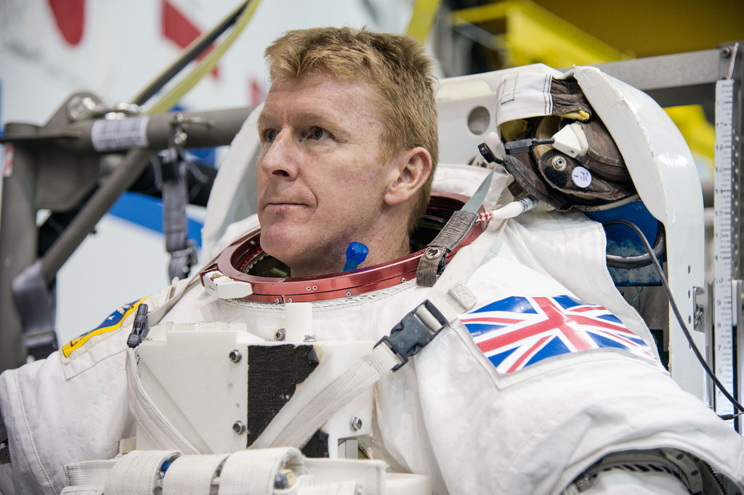
Congratulations Space Robotics Engineers!
You can continue to your mission at
www.destinationspace.uk
www.destinationspace.uk
www.destinationspace.uk

