Slide 1
Post mission debrief
www.destinationspace.uk
www.destinationspace.uk

Slide 2
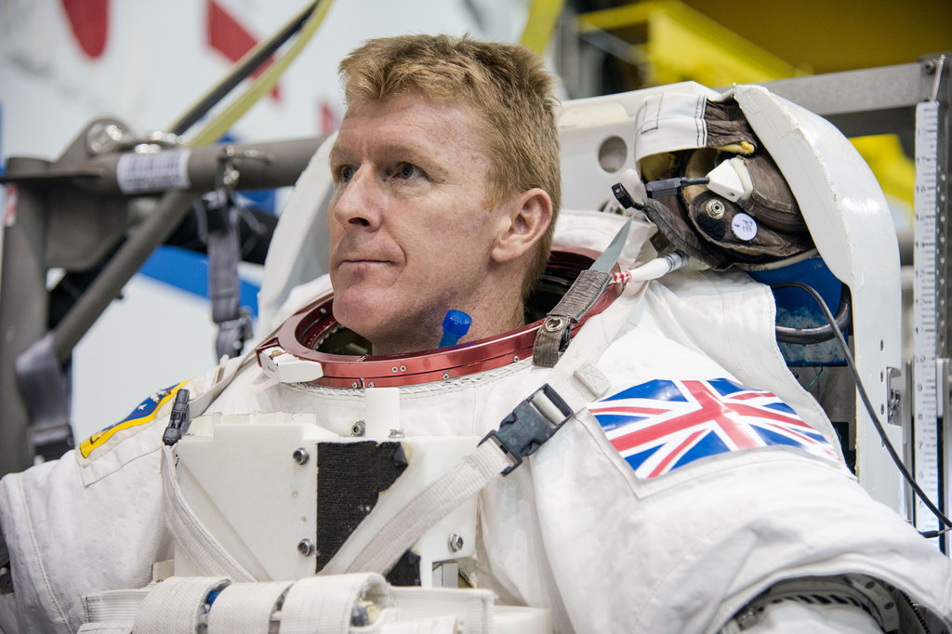
Congratulations on successfully completing your training mission!
We are going to check the things you learnt during your training.
www.destinationspace.uk
www.destinationspace.uk

Slide 3
Who does Tim Peake work for?
NASA
ESA
JAXA
National Aeronautics and Space Administration
(American space agency)
The European Space Agency
Japan Aerospace Exploration Agency
www.destinationspace.uk
www.destinationspace.uk

Slide 4
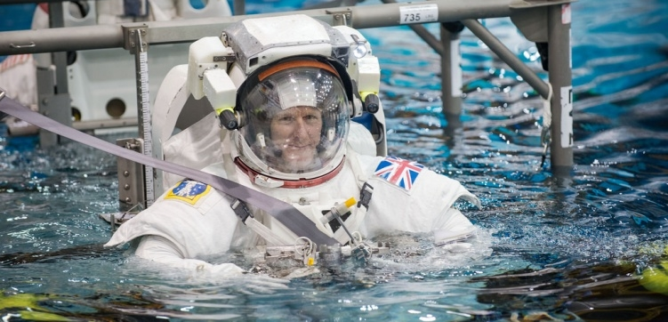
Tim was in space for 6 months (Dec 2015
to May 2016). How long was his training?
6 weeks
6 months
6 years
www.destinationspace.uk
www.destinationspace.uk

Slide 5
Spacewalk training…
Here Tim was training in a giant pool.
An internet connection is required to watch this video

Slide 6
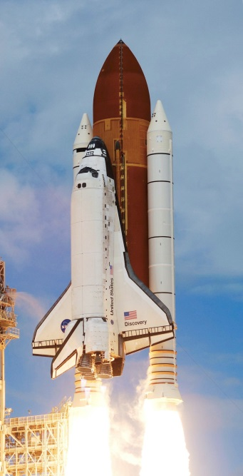
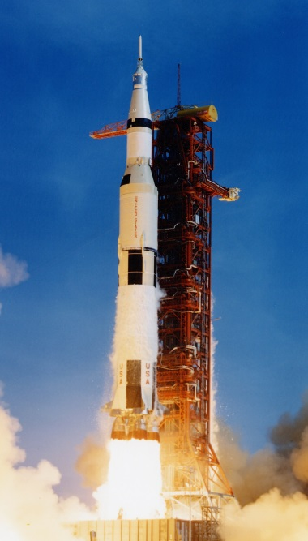
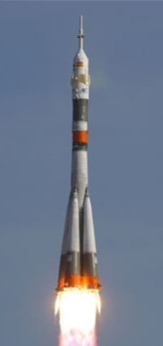
How did Tim Peake get to space?
Space shuttle
Saturn V rocket
Soyuz rocket
NASA’s shuttles retired in 2011
Saturn V took Apollo astronauts to the Moon in 60s & 70s
The Soyuz is a Russian rocket used to take astronauts to the ISS
www.destinationspace.uk
www.destinationspace.uk

Slide 7
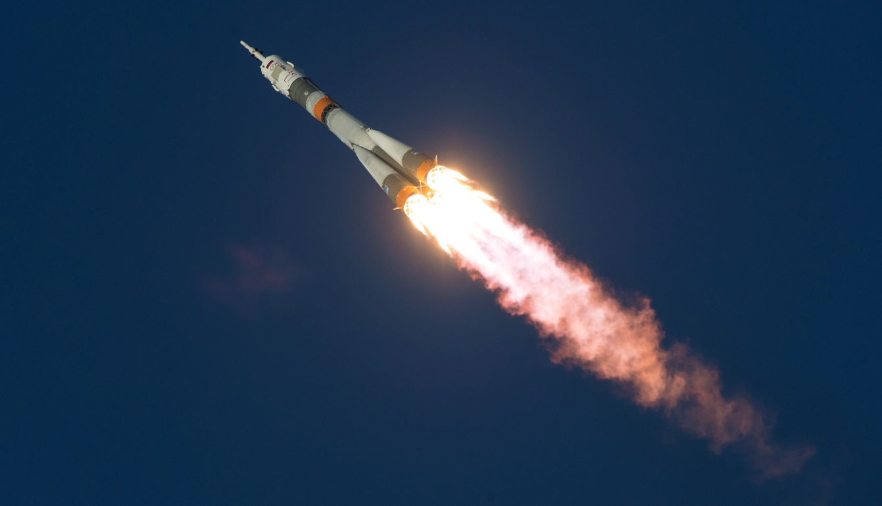
Rockets need fuel, something to light the
fuel and what other thing to launch?
Carbon Dioxide
Oxygen
Gravity
www.destinationspace.uk
www.destinationspace.uk

Slide 8
Where did Tim go in space?
The Moon
MIR Space Station
International Space Station
www.destinationspace.uk
www.destinationspace.uk

Slide 9
Tim’s first moments in space…
Watch again Tim’s launch on 15th Dec 2015.
An internet connection is required to watch this video

Slide 10
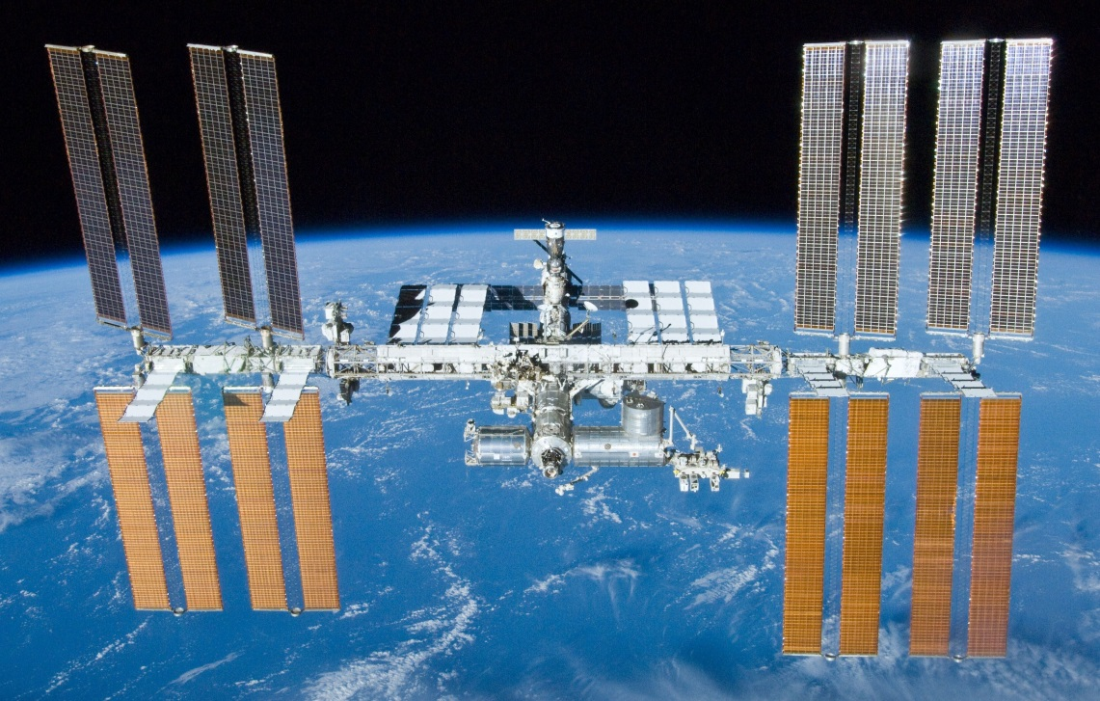
How far is the ISS above the Earth’s surface?
350 kilometres
3,500 kilometres
350,000 kilometres
How far an eight year old girl ran over 55 days in 2007
Almost the distance to the Moon (384,400 km)
www.destinationspace.uk
www.destinationspace.uk

Slide 11
How long does it take the ISS to orbit the
Earth once?
1 minute
1.5 hours
24 hours
www.destinationspace.uk
www.destinationspace.uk

Slide 12
Check out the view…
The ISS is orbiting Earth at 28,000 km per hour.
An internet connection is required to watch this video

Slide 13
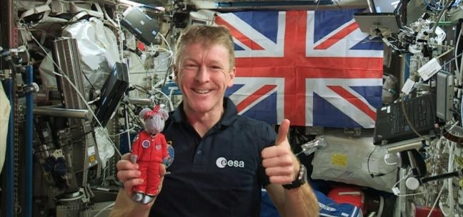
What is the astronauts’ main job on the ISS?
To perform science experiments
To observe space
To take pictures of the Earth
www.destinationspace.uk
www.destinationspace.uk

Slide 14
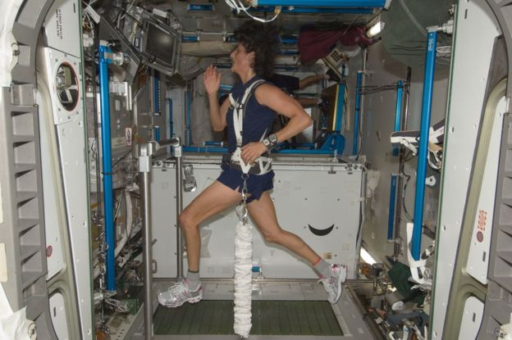
How long to astronauts have to exercise for
every day?
15 minutes
2 hours
4 hours
www.destinationspace.uk
www.destinationspace.uk

Slide 15
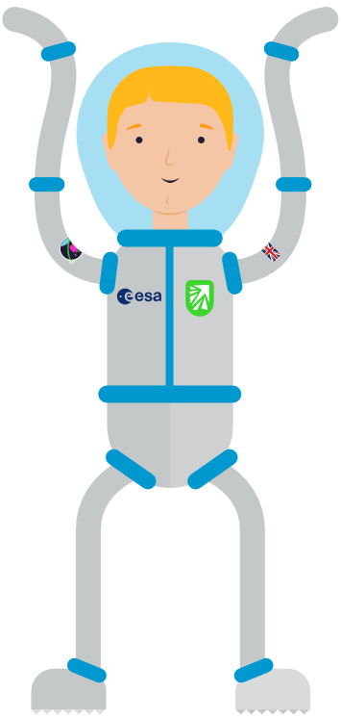
What would you like to see Tim do?
Answer questions
Play “water ping-pong”
Do some cleaning
Show us the view
Use the loo!
Make a cup of coffee
Take a shower
Brush his teeth
Make space scrambled eggs
Click a thing to watch…
An internet connection is required to watch these videos

Slide 16
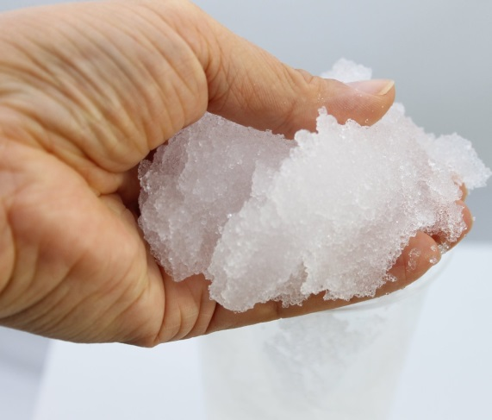
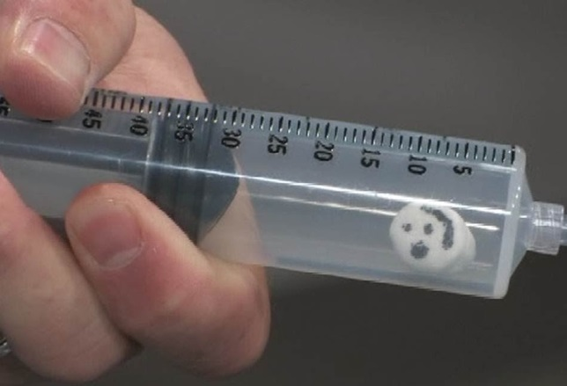
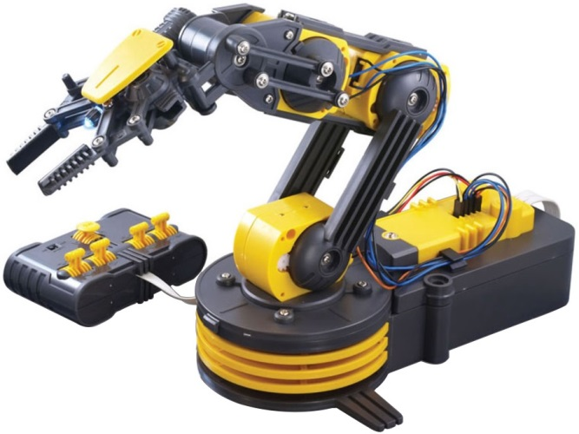
Your activities
In your workshop, you completed three activities...
Task 1 (b)
You found out what would happen to the human body if exposed to the vacuum of space
Task 2
You practiced moving things around the space station using a robotic arm
Task 1 (a)
You investigated what material was the best at absorbing water
www.destinationspace.uk

Slide 17
Task 1(a): Water absorption
Water behaves differently in space than it does on the Earth. Here is Canadian astronaut Chris Hadfield showing what happens if an astronaut cries.
An internet connection is required to watch this video

Slide 18
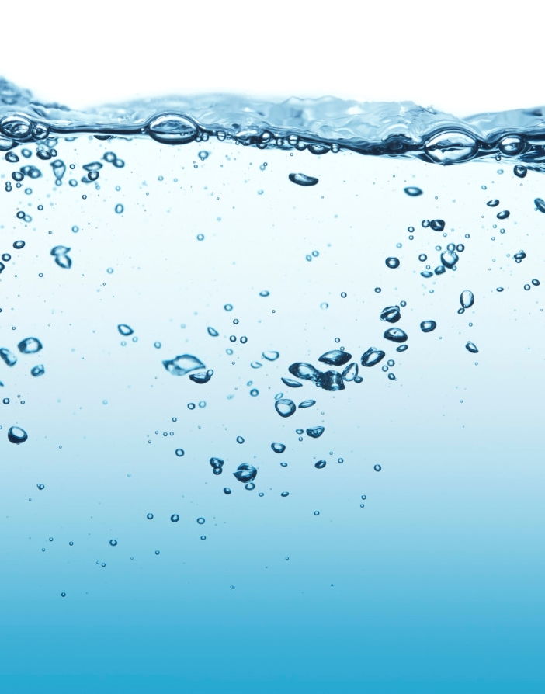
Which material absorbed the most water?
Compare your results with other groups.
Did all groups agree on the same material?
Scientists always share their results with other scientists to check their conclusions were right.
Can you think of any times when water absorption is an important issue in space?
www.destinationspace.uk

Slide 19
Why is water absorption important? Think about spacewalks…
On 15th January 2016, Tim Peake became the first British person to do a spacewalk. Tim (and American astronaut Tim Kopra) put on a spacesuit and went outside the ISS to do some repairs. They were out for 4 hrs, 43 mins.
An internet connection is required to watch this video

Slide 20
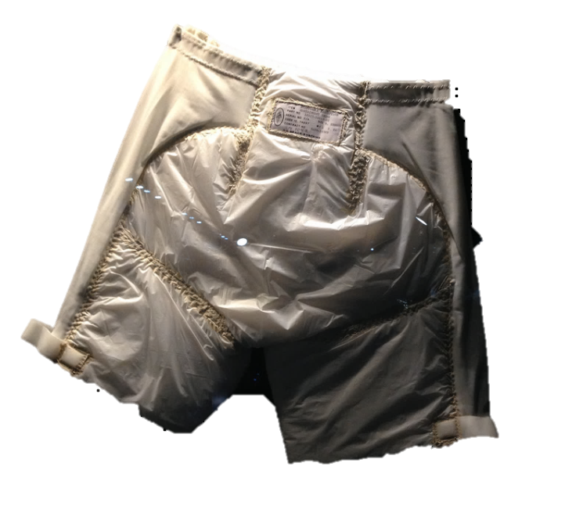
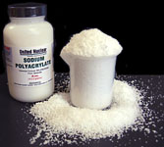
The Maximum Absorbency Garment
Because spacewalks last many hours, the first part of a spacesuit to be put on is the Maximum Absorbency Garment.
This is basically an adult-sized nappy!
It is full of the really absorbent material you tested in your workshop – Sodium polyacrylate (SPA).
SPA can absorb up to 300 times it’s own weight in water!
Floating liquids during spacewalks can be very dangerous…
www.destinationspace.uk

Slide 21
On 16th July 2013 Italian astronaut Luca Parmitano nearly drowned during a spacewalk. A water leak started inside his helmet. The water stuck to his head and began building up, creeping up and around his head. The spacewalk was aborted and he safely returned inside. Had the water covered his nose and mouth, he would not have been able to breathe.
An internet connection is required to watch this video

Slide 22
Task 1(b): Air pressure
In the workshop, you investigated what happens to marshmallows when you put them in an expanding syringe…
An internet connection is required to watch this video

Slide 23
What happened?
What did you notice happening to the marshmallows?
Compare your results to other groups – do all the groups agree?
Can you think why that happened to them?
www.destinationspace.uk

Slide 24
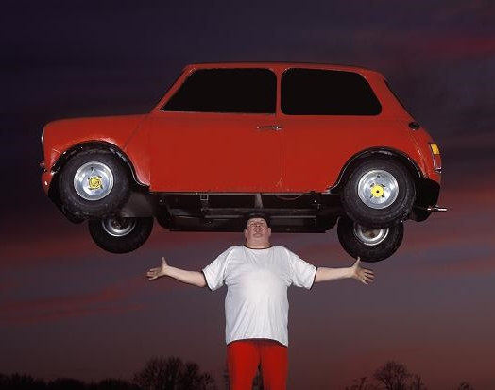
Why did that happen?
In order to explain why this happened to the marshmallow, we need to think about the air.
Did you know, the air actually weighs something?
In fact, all the air pressing down on you right now weighs about a tonne on your head!
That’s about as much as a small car!
www.destinationspace.uk

Slide 25
Why did that happen?
Our bodies aren’t squashed by that massive weight of air, because they push outwards by an equal amount.
But, space is a vacuum. What does that mean?
A vacuum is total emptiness – not even any air!
So if a person was in empty space, there would be no press on them from the air… but their body would still push outwards!
This means their body would expand outwards!
This is what happened to the marshmallow in the syringe.
By pulling on the syringe, you were reducing the amount that the air was pressing on the marshmallow.
www.destinationspace.uk

Slide 26
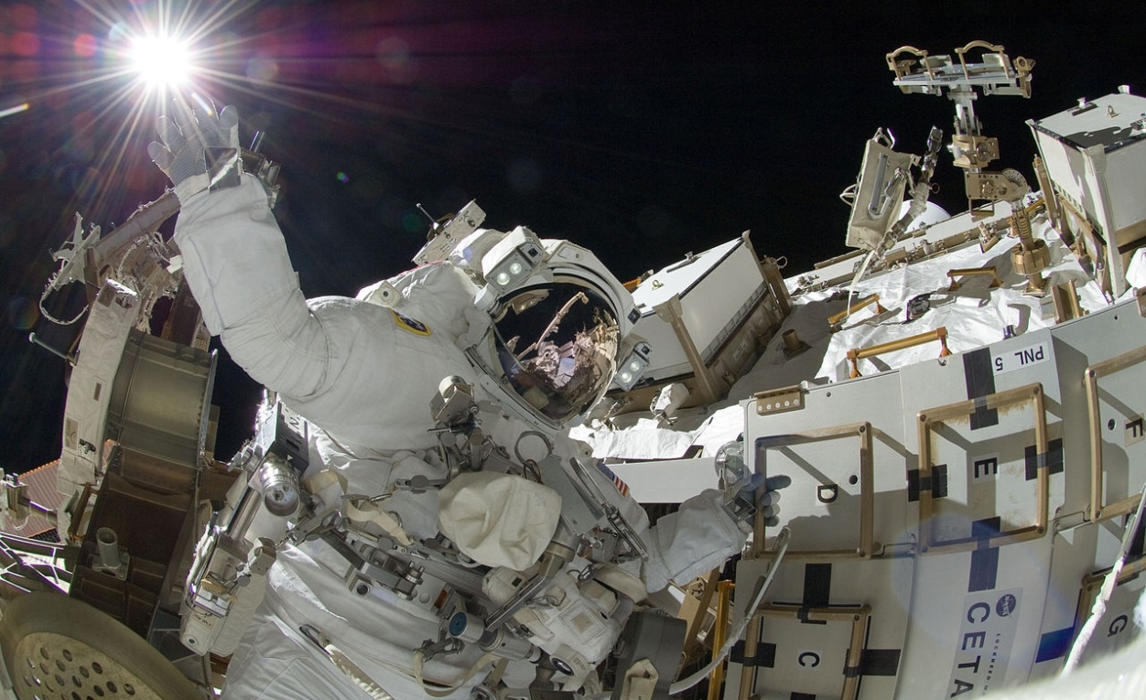
Spacesuits
This is one of the reasons that astronauts going outside the ISS must put on a spacesuit.
Spacesuits trap a layer of air around the body, so there is still enough of a press on the body.
Astronaut Sunita Williams on 5th September 2012
www.destinationspace.uk

Slide 27
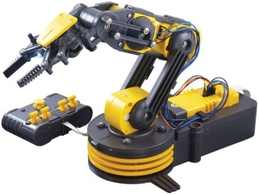
Task 2: Robotic arms
The ISS has a robotic arm: Canadarm2
Astronauts can control the arm remotely from inside the station.
Why do you think astronauts use a robotic arm?
An internet connection is required to watch this video

Slide 28
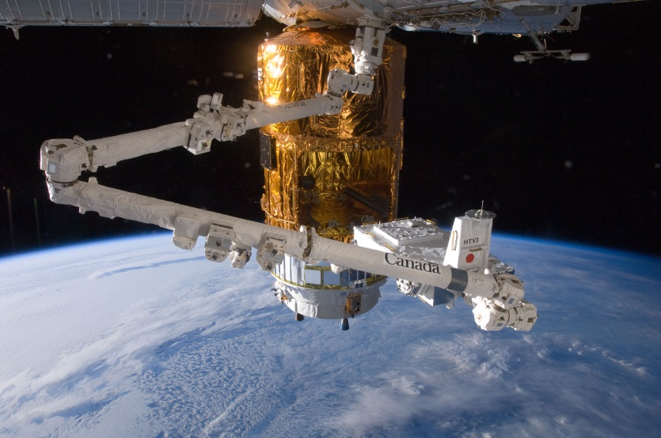
Using a robotic arm means that astronauts do not have to go outside and do a spacewalk, which can be dangerous.
Think about and discuss the following questions…
Was the robot arm difficult to use? Why or why not?
How did you work together as a team?
Do you think using the real robot arm on the ISS would be easier, or harder than the robot arm you used? Why?
www.destinationspace.uk

Slide 29
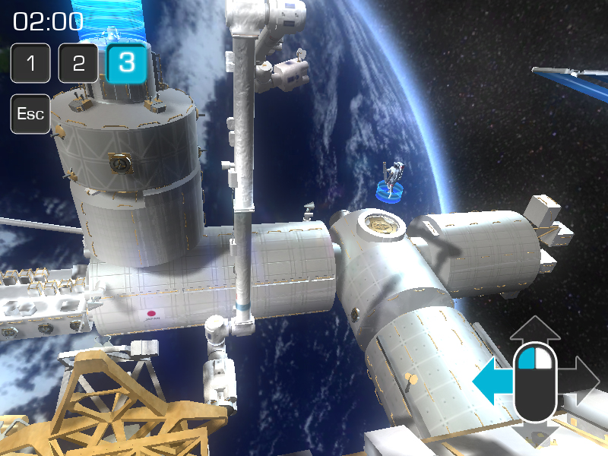
If you want to see what it’s like using the real Canadarm2, there’s an online game you can try at www.asc-csa.gc.ca/eng/multimedia/games/canadarm2!
www.destinationspace.uk

Slide 30
Congratulations on your post-training debrief!
You can continue to your mission at
www.destinationspace.uk
www.destinationspace.uk
www.destinationspace.uk

Slide 31
Optional task: Water filtering
In the workshop, you tested three materials to see which was the best at filtering water.
Which material was the best?
Compare your results - do all groups agree?
Why do you think this material was the best?
www.destinationspace.uk

Slide 32
Water filtering
Filters contain small holes, which allow water through, but stop bits of dirt getting through.
The smaller the holes, the more dirt will be stopped.
Although you can’t see them, filter paper contains holes. The holes are so small, they’re microscopic!
This makes filter paper an excellent way to make water clean.
Why do the astronauts need to make water clean on the ISS?
www.destinationspace.uk

Slide 33
We need a lot of water to survive and to do chores like washing. Sending all that water into space would be very expensive. The ISS has a water recycling system. This collects used water, which is then cleaned using filters. Here’s Chris Hadfield again to tell us more…
An internet connection is required to watch this video

