Slide 1

Post mission debrief
www.destinationspace.uk
www.destinationspace.uk

Slide 2
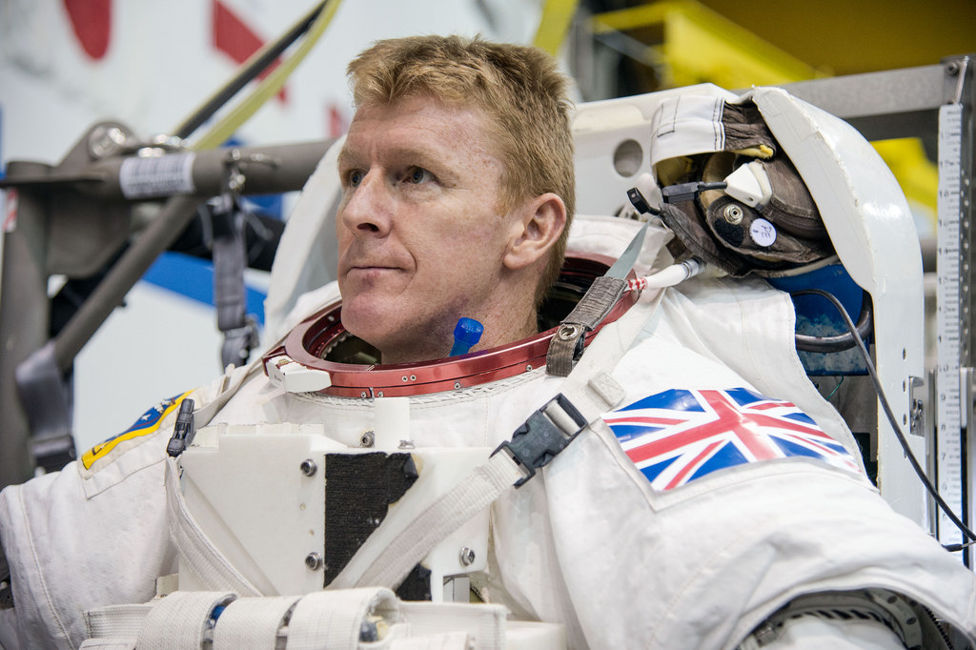
Congratulations on successfully completing your training mission!
We are going to check what you learnt during your training.
www.destinationspace.uk
www.destinationspace.uk

Slide 3



Who does Tim Peake work for?
  NASA
  ESA
  JAXA
National Aeronautics and Space Administration
(American space agency)
The European Space Agency
Japan Aerospace Exploration Agency
www.destinationspace.uk
www.destinationspace.uk

Slide 4
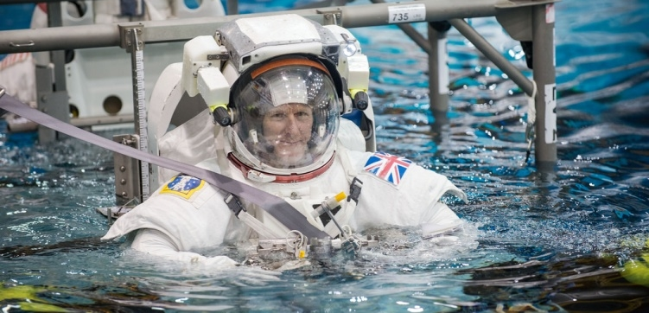
Tim was in space for 6 months (Dec 2015
to June 2016). How long was his training?
  6 weeks
  6 months
  6 years
www.destinationspace.uk
www.destinationspace.uk

Slide 5

Spacewalk training…
Here Tim was training in a giant pool.
An internet connection is required to watch this video

Slide 6
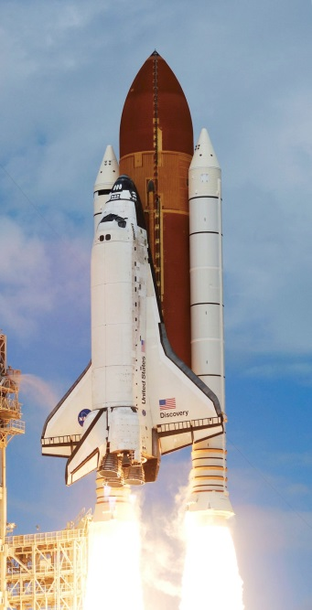
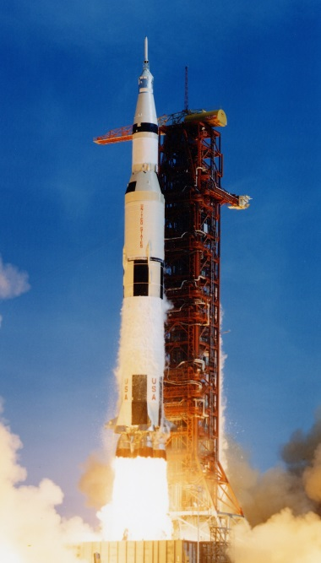
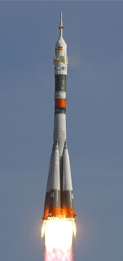
How did Tim Peake get to space?
  Space shuttle
  Saturn V rocket
  Soyuz rocket
NASA’s shuttles retired in 2011
Saturn V took Apollo astronauts to the Moon in 60s & 70s
The Soyuz is a Russian rocket used to take astronauts to the ISS
www.destinationspace.uk
www.destinationspace.uk

Slide 7
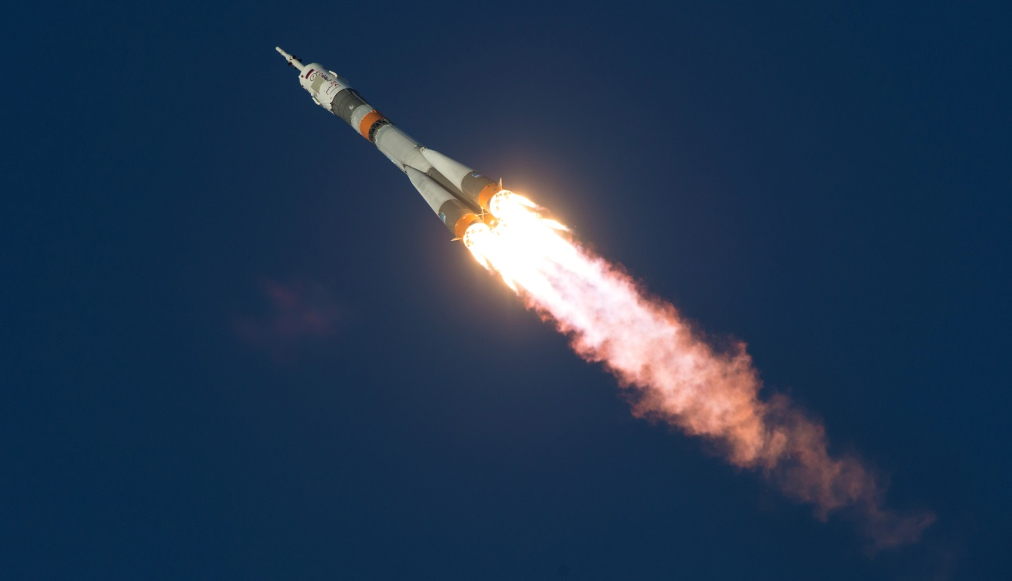
Rockets need fuel, an ignition source and what other thing to launch?
  Carbon Dioxide
  Oxygen
  Gravity
www.destinationspace.uk
www.destinationspace.uk

Slide 8
Where did Tim go in space?
  The Moon
  MIR Space Station
  International Space Station
www.destinationspace.uk
www.destinationspace.uk

Slide 9
Tim’s first moments in space…
Watch again Tim’s launch on 15th Dec 2015.
An internet connection is required to watch this video

Slide 10
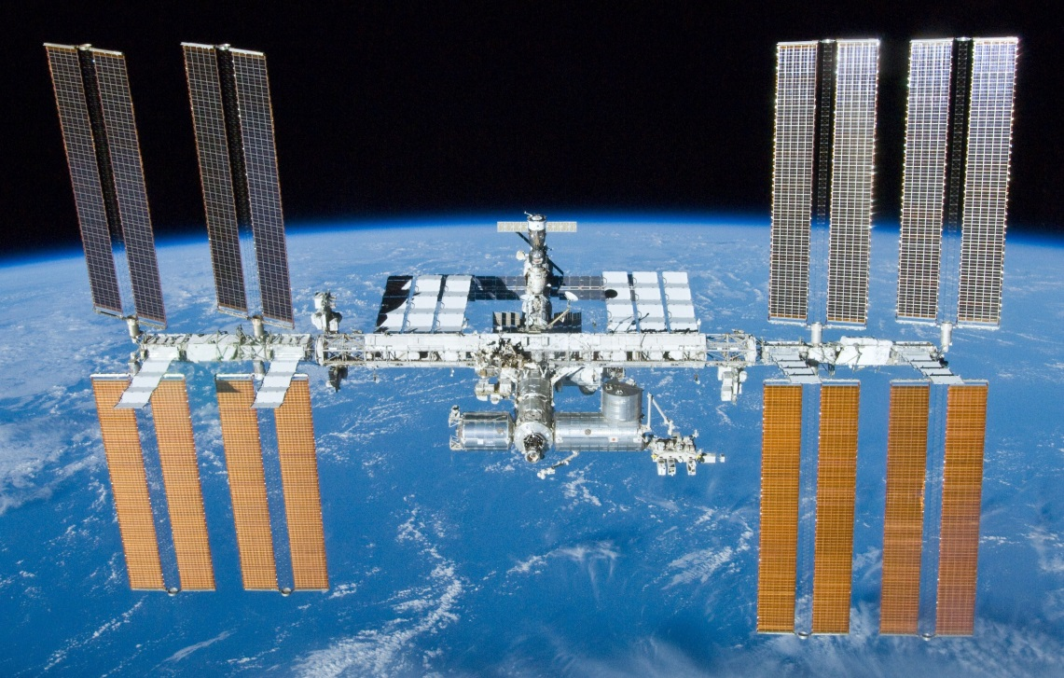
How far is the ISS above the Earth’s surface?
  350 kilometres
  3,500 kilometres
  350,000 kilometres
How far an eight year old girl ran over 55 days in 2007
Almost the distance to the Moon (384,400 km)
www.destinationspace.uk
www.destinationspace.uk

Slide 11
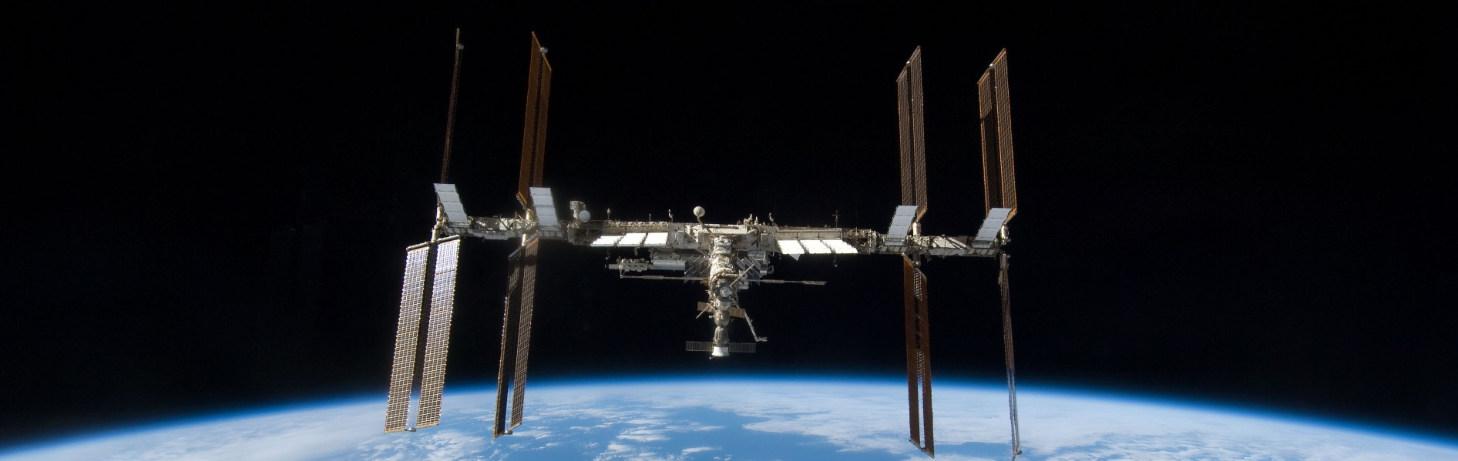
How long does it take the ISS to orbit the
  Earth once?
  1 minute
  1.5 hours
  24 hours
www.destinationspace.uk
www.destinationspace.uk

Slide 12
Check out the view…
The ISS is orbiting Earth at 28,000 km per hour.
An internet connection is required to watch this video

Slide 13
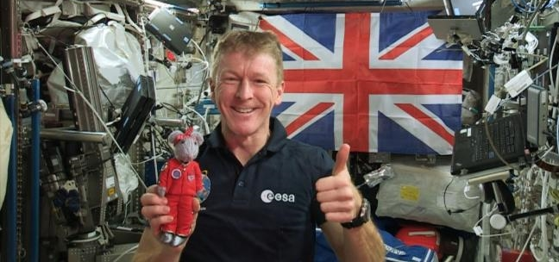
What is the astronauts’ main job on the ISS?
  To perform science experiments
  To observe space
  To take pictures of the Earth
www.destinationspace.uk
www.destinationspace.uk

Slide 14
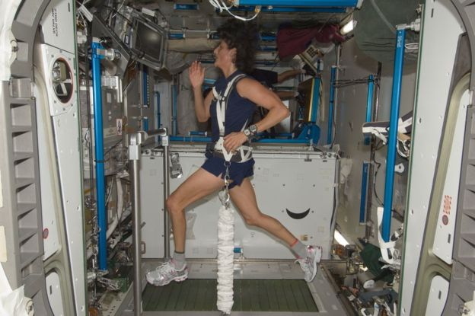
How long do astronauts have to exercise for
every day?
  15 minutes
  2 hours
  4 hours
www.destinationspace.uk
www.destinationspace.uk

Slide 15
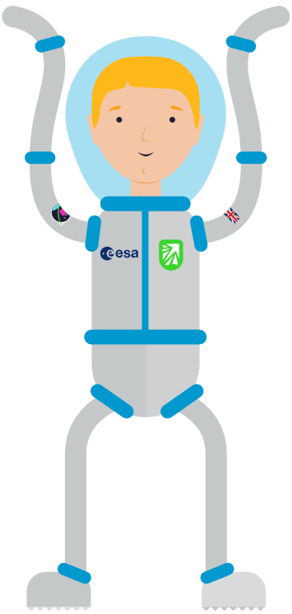
What would you like to see Tim do?
Answer questions
Play “water ping-pong”
Do some cleaning
Show us the view
Use the loo!
Make a cup of coffee
Take a shower
Brush his teeth
Make space scrambled eggs
Click a thing to watch…
An internet connection is required to watch these videos

Slide 16
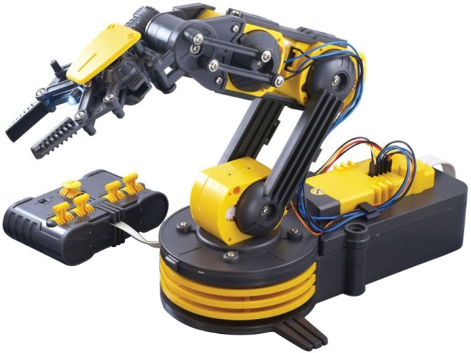
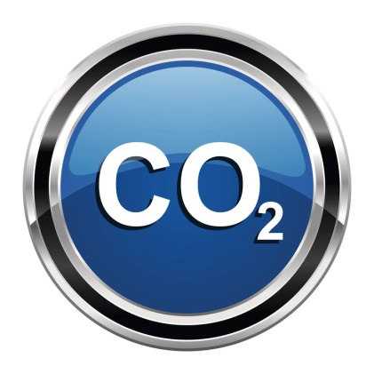
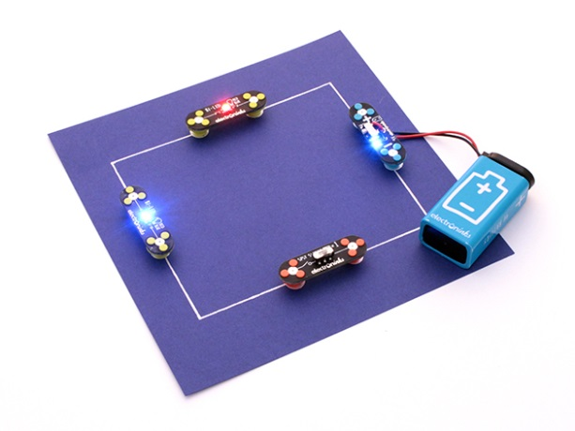
Your activities
In your workshop, you completed three activities...
Task 1
You tested three materials to see which was the best at absorbing carbon dioxide
Task 3
You practiced moving things around the space station using a robotic arm
Task 2
You drew circuits using a conductive pen
www.destinationspace.uk

Slide 17
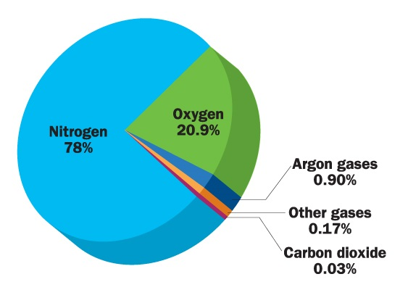
Task 1: CO₂ absorption
We release energy by respiration. Complete the following respiration equation…
?
Glucose + Oxygen → Carbon Dioxide + Water
?
The International Space Station is a closed environment.
If nothing was done to control this reaction, what would happen to the air on-board?
If left unchecked, the oxygen levels would decrease and the carbon dioxide levels would rise.
The rising carbon dioxide would kill astronauts much quicker than the decreasing oxygen.
Composition of air
www.destinationspace.uk

Slide 18
Deadly CO₂
Carbon dioxide only accounts for about 0.03% of the air around us.
If this rises to 1%, you would start to feel drowsy.
At 3% you would be breathing twice as fast as normal.
Levels of 5% or more are toxic.
In 1970, whilst on the way to the Moon, an explosion on-board Apollo 13 caused part of the spacecraft to become unusable. The mission was aborted and the three NASA astronauts used the lunar lander as a lifeboat, whilst they returned to Earth.
Unfortunately, there was a problem. The lunar lander was designed to hold two astronauts for a day and a half, not three astronauts for four days.
Carbon dioxide levels in the lunar lander quickly began to rise and would soon become deadly. Mission control had to figure out a way to save the astronauts…
www.destinationspace.uk

Slide 19
This is a clip of the 1995 movie Apollo 13, which shows the real solution Mission Control came up with… (some bad language at 1:58)
An internet connection is required to watch this video

Slide 20
So how is excess carbon dioxide removed on-board the ISS?
An internet connection is required to watch this video

Slide 21
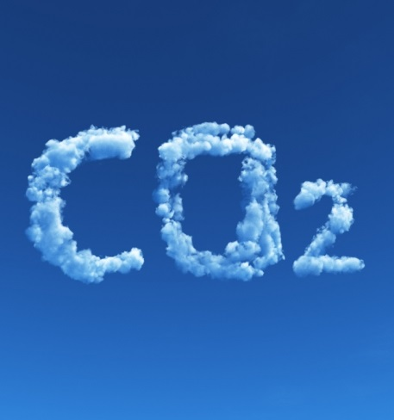
Which material absorbed the most CO₂?
Look at your results.
Which material was the best at absorbing CO2 and how do you know this?
Compare your results with other groups.
Did all groups agree on the same material?
List the ways you made your test a fair one.
List some sources of error that may have occurred in your test.
www.destinationspace.uk

Slide 22
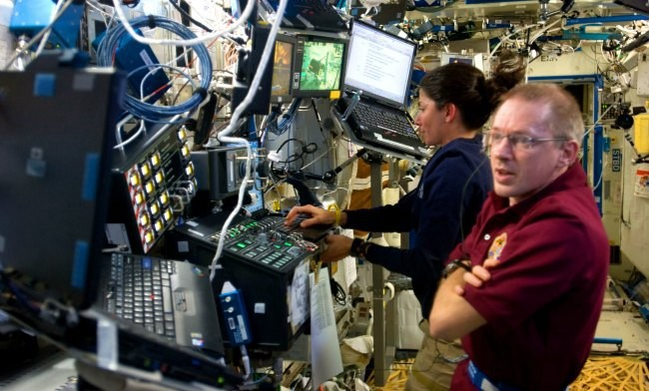
Task 2: Circuits
The ISS contains an enormous amount of electrical cables. For the power system alone, there’s an incredible 13 km of wires.
www.destinationspace.uk

Slide 23
Making backup plans…
All the systems on the ISS have backups (and backup-backups) so if something breaks, things can usually keep working.
Astronauts get some training in electrical engineering, so they’re able to fix things in case something does break.
Even if something does go seriously wrong, the station is wired up to be modular. That means, the different parts don’t rely on each other. If the power to a section goes down, the astronauts can just close off that section, then live in another section, until they are able to fix the problem.
In the event of something catastrophic happening, the astronauts can always head straight to the Soyuz capsules and perform an emergency descent back to Earth.
www.destinationspace.uk

Slide 24
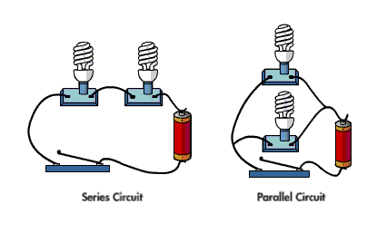
Your circuits
What are the two types of circuit?
  Series & Parallel
www.destinationspace.uk

Slide 25
Your circuits
2) What difference do you notice between the brightness of the LEDs when in series and parallel?
In series, the first light is brighter than the second. In parallel, they are equally bright.
3) If you remove one component from the series circuit, what happens to the other? Why do you think this is?
If you remove one component, all remaining lights turn off. This is because the circuit is broken, as there is only one way for the current to travel.
4) If you remove one component from the parallel circuit, what happens to the others? Why do you think this is?
The other light will stay on. This is because there are separate paths for the current – there is still a complete circuit.
www.destinationspace.uk

Slide 26
Task: Fixing the Columbus module
The Columbus module is the European Space Agency’s research module on the ISS. Following a small fire, some of the wiring needs to be replaced.
You must construct the right circuit to allow the astronauts to start using the module again.
Circuit must include:
1 power supply.
2 experiment racks. If one if these breaks, the other one still needs to work.
1 cooling system. If this breaks, all of the other equipment needs to stop working in order to prevent the module overheating.
Solution shown on the next slide…
www.destinationspace.uk

Slide 27
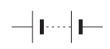
Solution: Fixing the Columbus module
Experiment rack 1
Experiment rack 2
Cooling system
www.destinationspace.uk

Slide 28
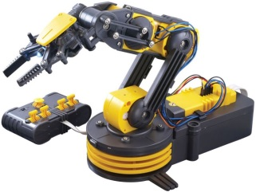
Task 3: Robotic arms
The ISS has a robotic arm: Canadarm2
Astronauts can control the arm remotely from inside the station.
Why do you think astronauts use a robotic arm?
An internet connection is required to watch this video

Slide 29

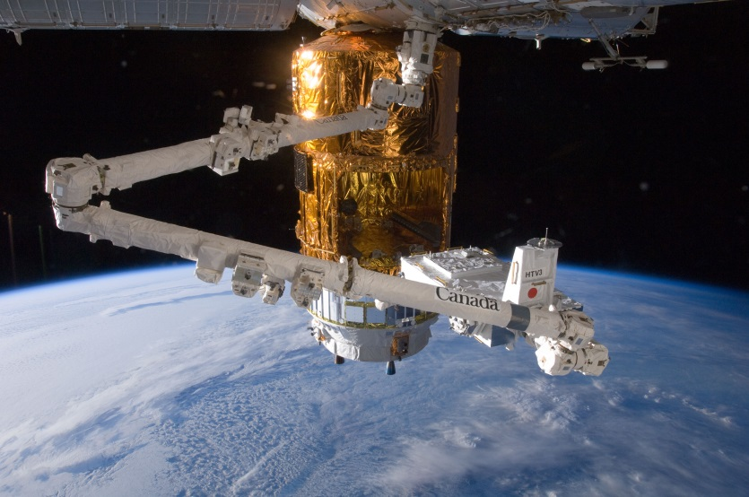
Using a robotic arm means that astronauts do not have to go outside and do a spacewalk, which can be dangerous.
Think about and discuss the following questions…
Was the robot arm difficult to use? Why or why not?
How did you work together as a team?
Do you think using the real robot arm on the ISS would be easier, or harder than the robot arm you used? Why?
www.destinationspace.uk

Slide 30

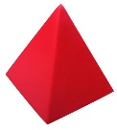

Answers to the robot arm questions…
1. What kind of a reaction takes place in a rocket engine?
Respiration
Endothermic
Combustion
Reduction
www.destinationspace.uk

Slide 31

Answers to the robot arm questions…
2. Water vapour and which other gas is produced in the reaction in the rocket engine?
Carbon dioxide
Oxygen
Nitrogen dioxide
Carbon monoxide
www.destinationspace.uk

Slide 32

Answers to the robot arm questions…
3. Complete Newton’s third law: For every action there is an equal and opposite…..
Motion
Reaction
Force
Acceleration
www.destinationspace.uk

Slide 33

Answers to the robot arm questions…
4. On the ISS the force of gravity is….
The same as on Earth
Zero
Almost the same as on Earth
Almost zero
www.destinationspace.uk

Slide 34
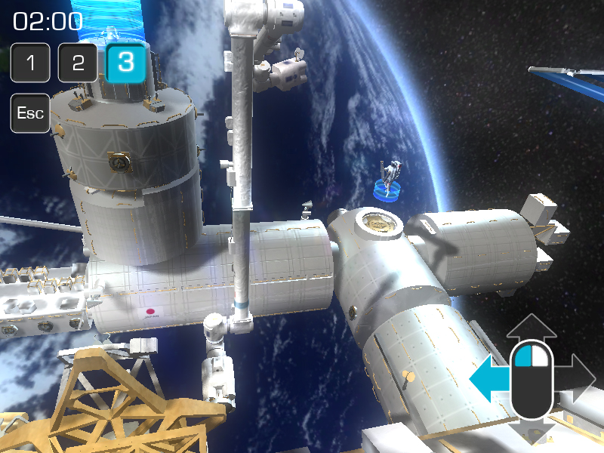
If you want to see what it’s like using the real Canadarm2, there’s an online game you can try at www.asc-csa.gc.ca/eng/multimedia/games/canadarm2!
www.destinationspace.uk

Slide 35

Congratulations on your post-training debrief!
You can continue to your mission at
www.destinationspace.uk
www.destinationspace.uk
www.destinationspace.uk

Slide 36
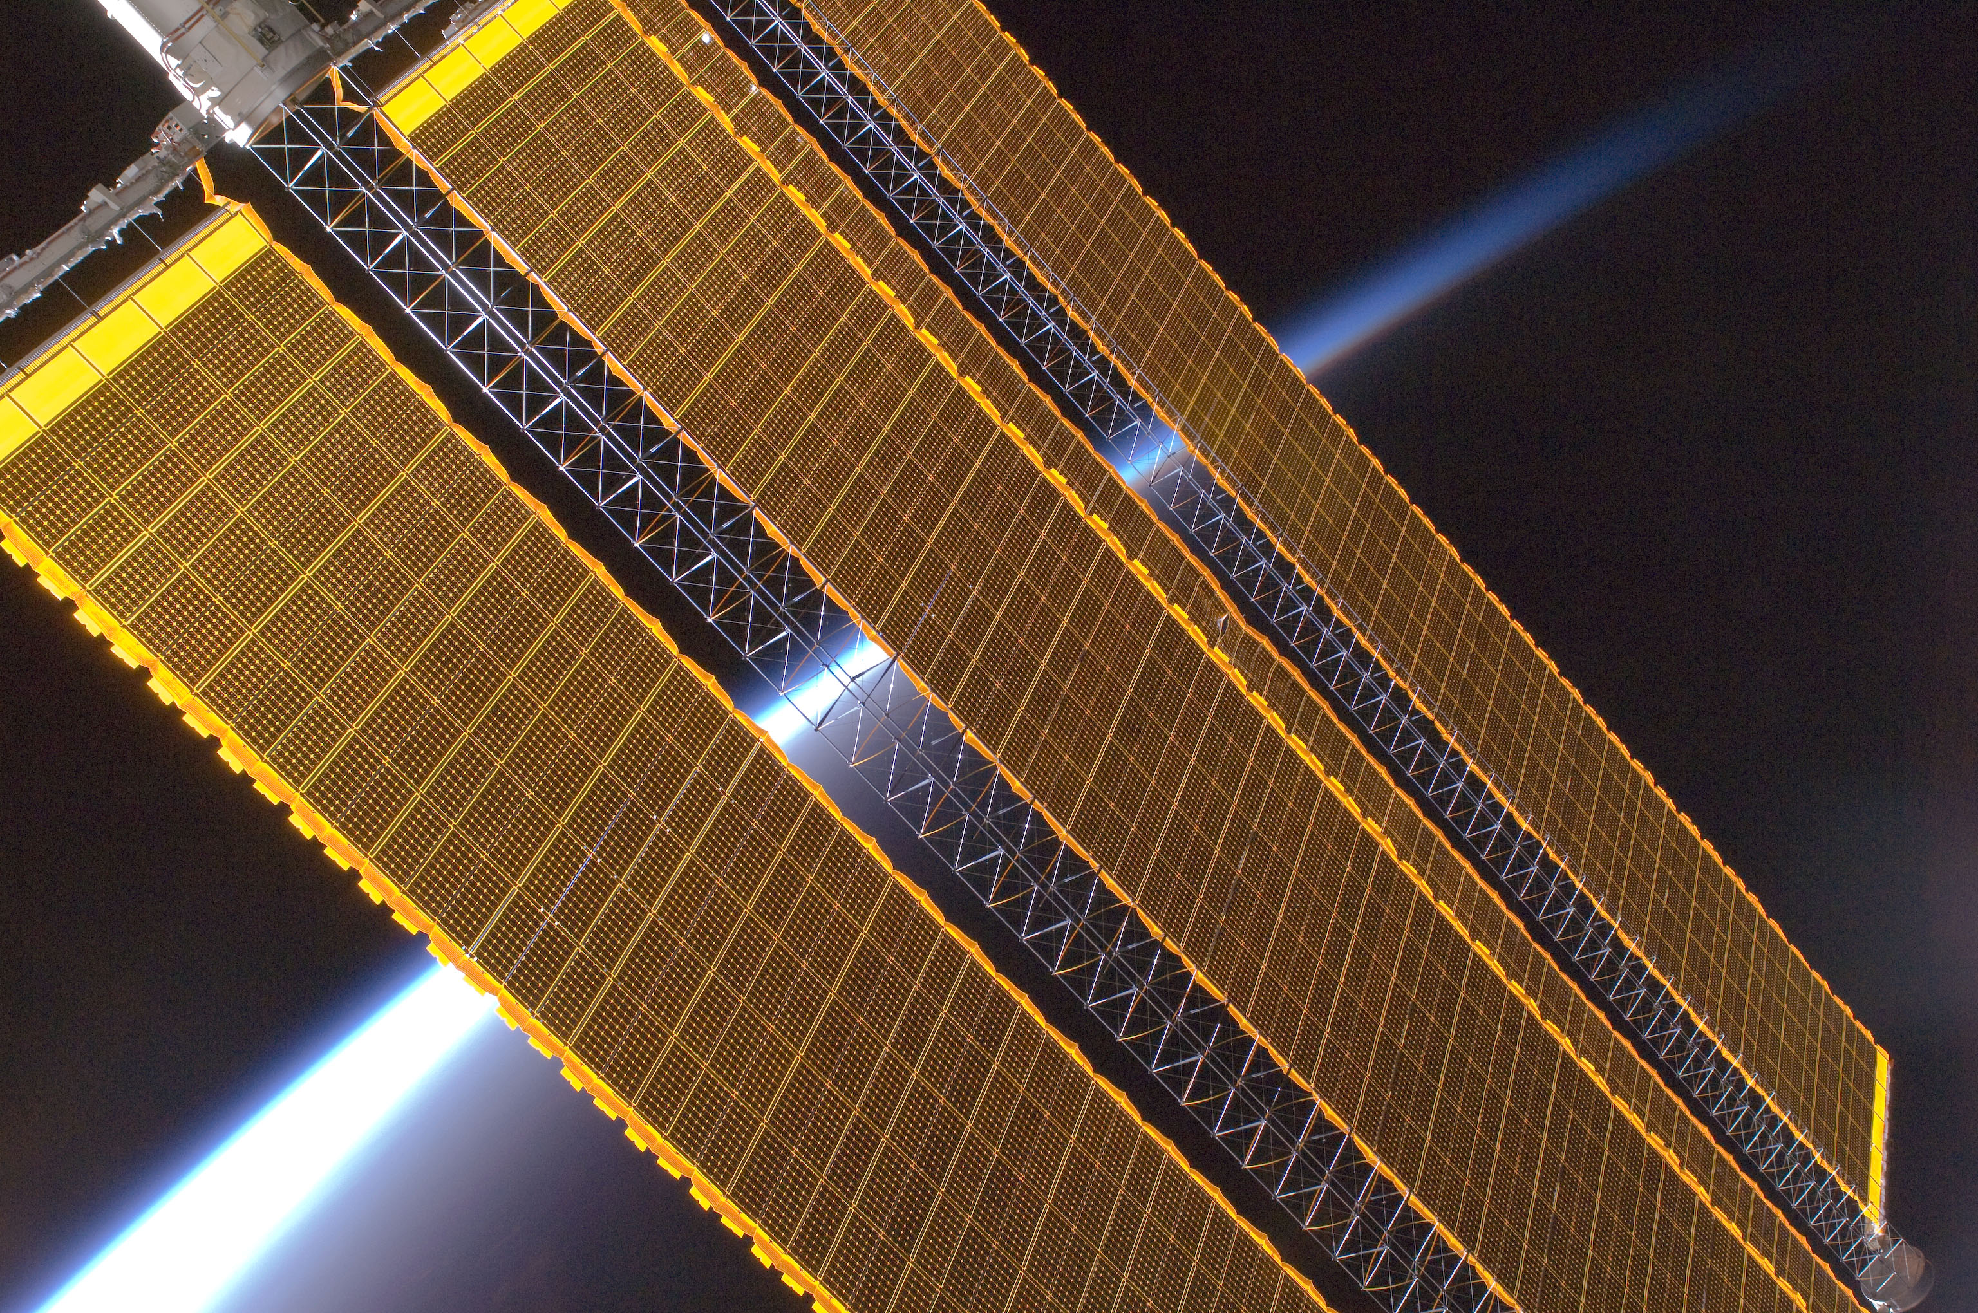
Optional task: Solar Panels
The ISS gets its power from 8 solar array ‘wings’.
Each wing is 34 metres long and 12 metres wide.
Altogether, the solar panels can produce 120 kilowatts of power – enough to power around 40 homes.
www.destinationspace.uk

Slide 37
As the ISS orbits the Earth, the solar panels must be angled towards the Sun…
An internet connection is required to watch this video

Slide 38
Your results
Which angle generated the largest voltage?
What were some of the ways you made it a fair test?
Why are the ‘corrected voltages’ a more accurate measure of the power generated from the lamp?
www.destinationspace.uk

